Slide 1
MD5 hash algorithm

Slide 2
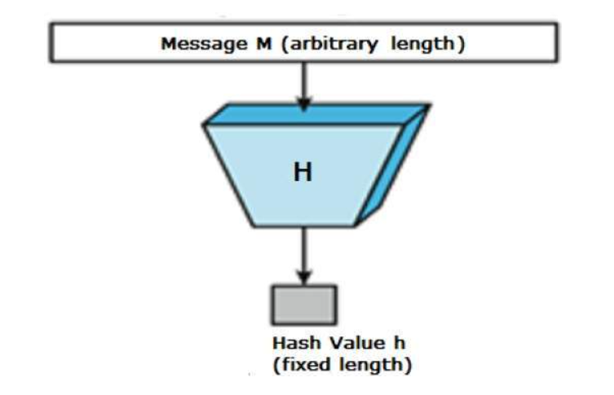
What is Hashing???
A hash function is a mathematical function that converts a numerical input value into another compressed numerical value. The input to the hash function is of arbitrary length but output is always of fixed length.
Values returned by a hash function are called message digest or simply hash values.

Slide 3
What is MD5?
The MD5 (message-digest algorithm) hashing algorithm is a one-way cryptographic function that accepts a message of any length as input and returns as output a fixed-length digest value to be used for authenticating the original message.
The MD5 hash function was originally designed for use as a secure cryptographic hash algorithm for authenticating digital signatures. But MD5 has been deprecated for uses other than as a noncryptographic checksum to verify data integrity and detect unintentional data corruption.

Slide 4
…
An MD5 hash is created by taking a string of an any length and encoding it into a 128-bit fingerprint. Encoding the same string using the MD5 algorithm will always result in the same 128-bit hash output.
MD5 hashes are commonly used with smaller strings when storing passwords, credit card numbers or other sensitive data in databases such as the popular MySQL

Slide 5
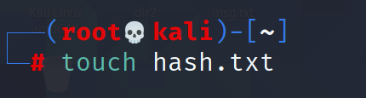
Practical Impementation
>>Open Terminal
Create a file
1>> touch hash.txt(file name)
2>>nano hash.txt
(Now write something in blank file . Then for exit press ctrl+q and save the data )

Slide 6
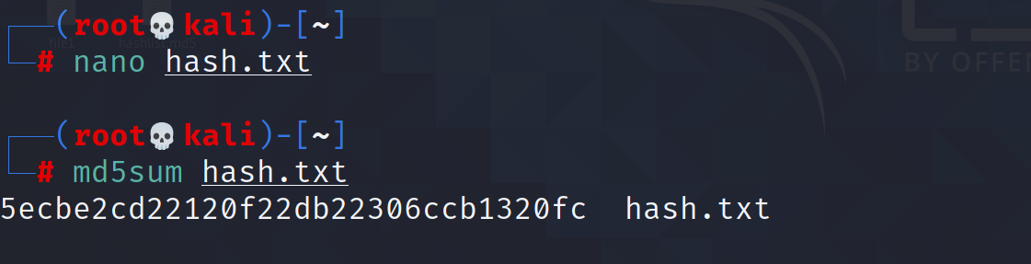
…
To Generate the HASH of a file.
3>> md5sum hash.txt
This command will print the message digest of a file named hash.txt

Slide 7
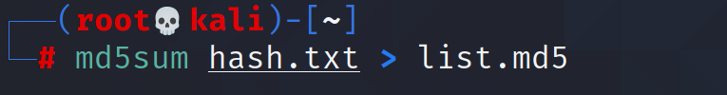
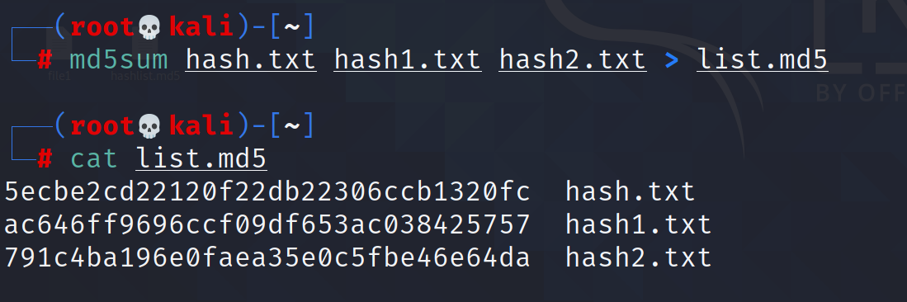
To save he MD5 in a List
4>> md5sum hash.txt > list.md5
List is useful when we have to check MD5 of multiple file. So, rather than storing message digest at different locations. We create a list and store all the hashes in it.

Slide 8
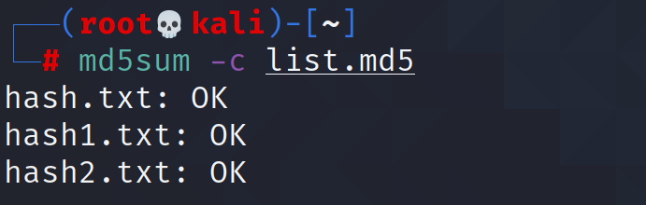
For integrity check
To compare the MD5 sums if any data is altered in the file.
5>> md5sum –c list.md5
“Ok” for each of the file is showing that no data modified.

Slide 9
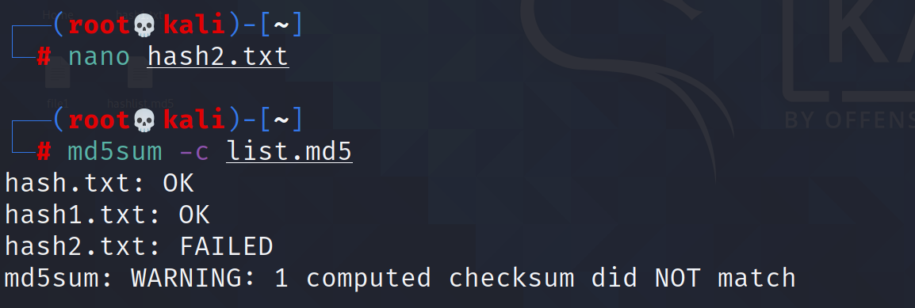
…
Now alter the data and compare the list again!!!
For file named hash2.txt, message shows “FAILED”. Which means file is modified, so MD5 do not match.

Slide 10
Thank you!!!

